Slide 1

Social Media Strategies to
Attract Homeowners

Slide 2
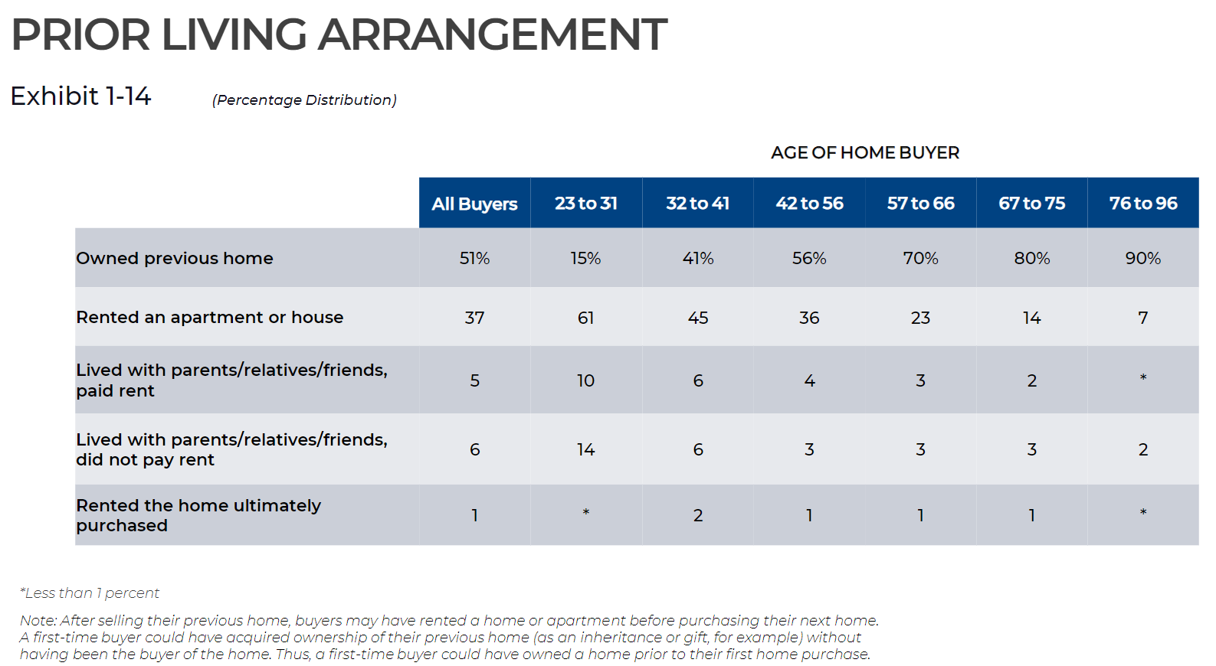
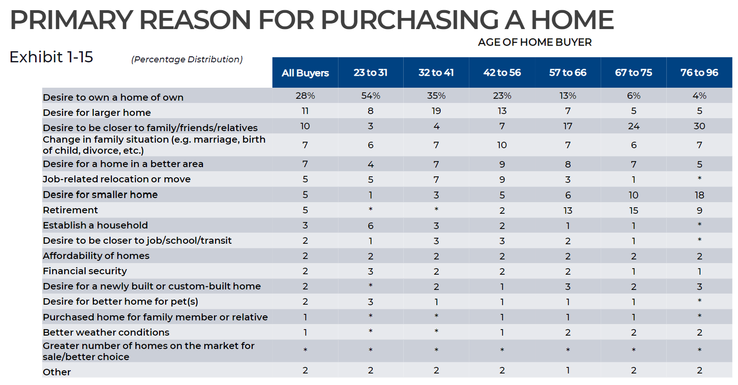


















Market Overview
51% of homebuyers in 2021 were repeat homebuyers
The second highest reason for purchasing a home is to get a larger one. Current homeowners can find value in your tools towards looking for a better home.

Slide 3
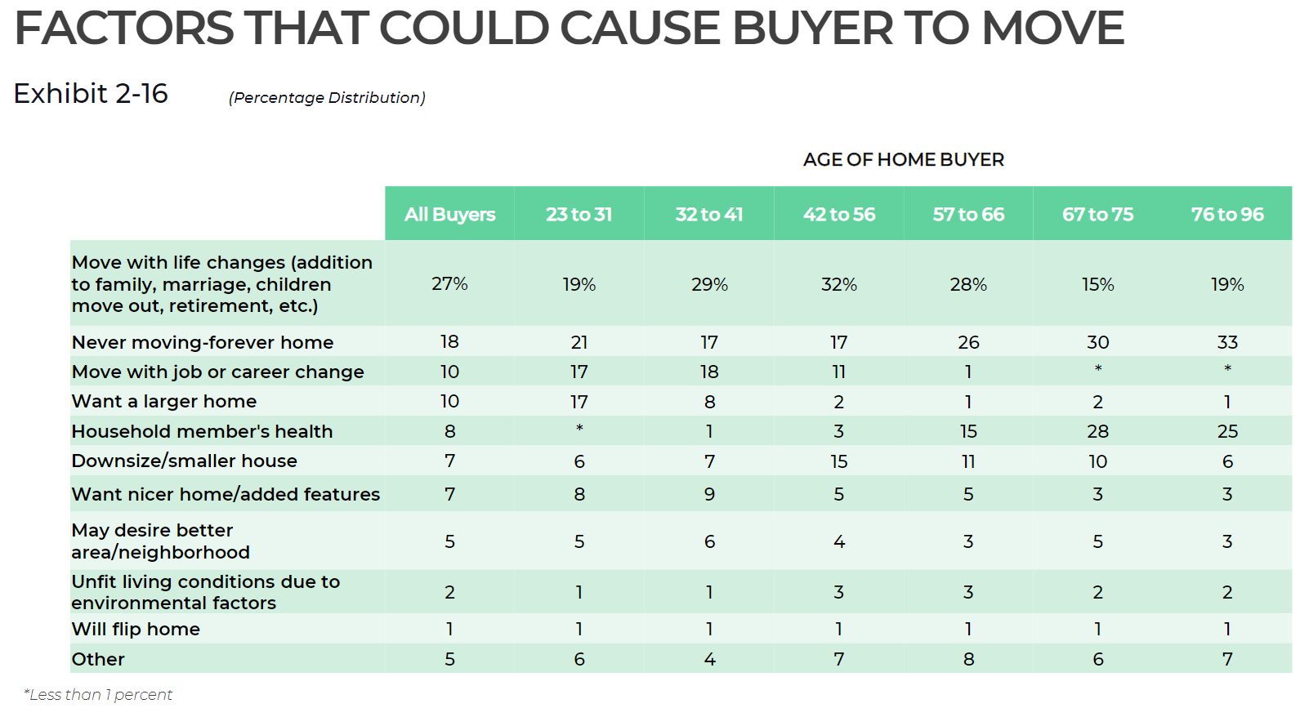
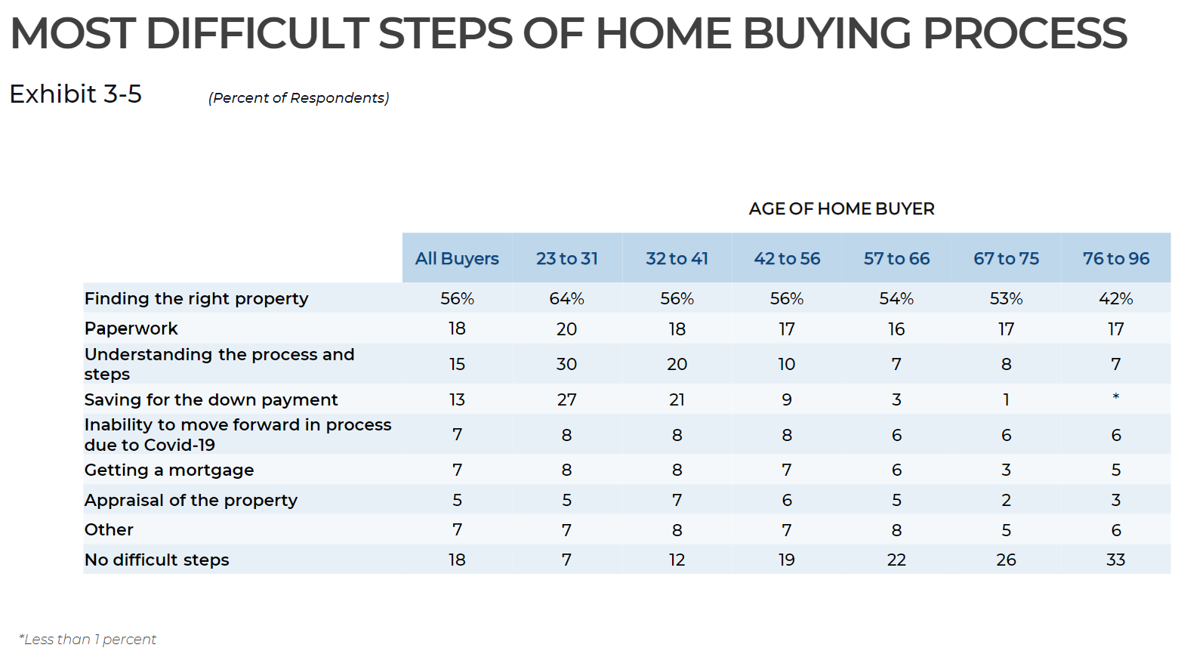
Market Overview
Knowing the life circumstances that result in a move will enable your team to create content that will benefit and attract existing homeowners.
FinLocker provides tools to alleviate the stress of the top four difficult steps of the homebuying process:
Property search
Share Center
Mortgage and homeownership education
Financial accounts, spending, home affordability calculator, trackable goals and budgets

Slide 4
Social Media Tactics
Get your feet wet
Instagram Stories are 15 seconds that only display for 24 hours. Captions can have up to 2,200 characters.
YouTube Shorts and Instagram Reels – 60 second videos that can be easily created on your phone. Videos are displayed in a consumer’s video feed based on their search algorithm, so it’s easier to get exposed to consumers not following your page but searching for first-time homebuying tips or financial planning.
TikTok is extremely informal. While the channel accepts videos up to 10 min, quicker videos with visually pleasing information are more popular. Think of TikTok as a video form of Wikipedia. If someone asks a question, they do not want a long explanation, they usually just want an answer. TikTok video descriptions increased to 2,200 characters in Sept.
Ideas:
  Renovation and remodeling tips for current homeowners
  Monthly home maintenance tips
  Tips to make a home energy efficient
  Tips to pay off mortgage faster
  Importance of creating an emergency fund
Feeling confident?
Create one 30 minute video for YouTube that explains each step of the refinance process
Add #hashtags to promote your #personalfinance and #homeownertips

Slide 5



TikTok
Image Link
Videos of remodel ideas and how the value of various home renovations can increase the value of a home
Greenscreen overlay that shows the budget section of the app
Visual graphs or charts to show costs for common home repairs and options for funding, e.g. emergency fund for simple repairs and appliance replacement and cash out refi for high costs repairs such as roof replacement
Image Link
Image Link

Slide 6

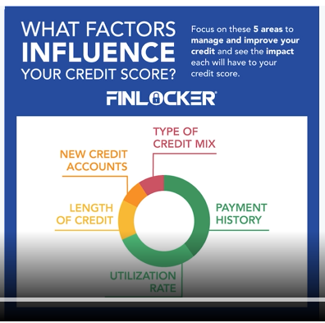
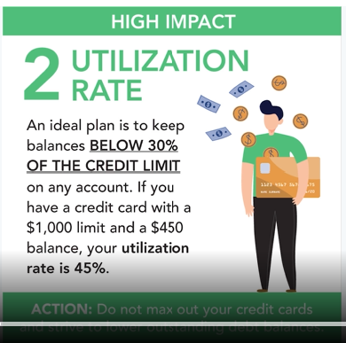


Maintain Credit
Knowing the factors that impact your credit score can help you to maintain your credit. Making payments on-time each month and maintaining a utilization rate below 45% makes up 65% of your credit score.
[Company] provides all users with access to their @TransUnion credit score and credit report. Open your free [app] account today to start building your credit and achieving your financial goals: [invitation link and code]
#CreditEducationMonth #creditreport #credit #credittips #buildcredit #creditcard #creditrepair #creditbalance #money #finance

Slide 7


Maintain Credit
To maintain your credit score, it’s important to use credit wisely. We’ve got six ways to build your credit while sensibly shopping for family and friends this holiday season.
https://finlocker.com/6-ways-to-build-your-credit-while-holiday-shopping/
Download [app], our free financial app to receive your credit score and credit report, and tools that will help you to manage your finances and achieve your financial goals. [invitation link and code]
#financialtips #financialplanning #credittips #creditreport #creditcard #creditrepair
Credit utilization has a major impact on your credit score. To maintain a good or excellent rating keep your credit utilization below 30%. If you have a credit card with a $2,000 limit and a $900 balance, your utilization rate is 45%. To lower your credit utilization, strive to lower your credit card balance.
[Company] makes it easy to monitor your credit utilization and credit score. Get our free [app] to build your credit, manage your finances and achieve your financial goals. [invitation link and code]
#wellbeingwednesday #credittips #credittips #creditreport #creditcard #creditrepair

Slide 8


Financial Literacy
Understanding all the factors that impact your credit score can improve your eligibility for credit. Our free financial app makes it easy to monitor your #creditscore, #creditreport, credit utilization ratio, and provides #crediteducation.
For more information on monitoring and improving your credit score, download [app], our free financial app! [invitation link and code]
#credittips #terminologytuesday #betterfinancialfuture #creditreport #creditcard #creditscore
Life throws surprises at us, sometimes costly ones. [Company] can help you to prepare to cover unexpected expenses by creating an emergency fund using your own savings account.
Our free financial management app provides credit monitoring, budgeting and savings tools to help you financially prepare for life's unexpected expenses. Download [app] today to start your emergency fund and achieve other financial goals.
[invitation link and code]
#terminologytuesday #financialplanning #betterfinancialfuture #fund #emergencyfund #saving #savings #savingmoney

Slide 9



Investing in Your Future
Homeowners have a median net worth of $255,000 while renters only have a net worth of $6,300. Here’s four more reasons why purchasing a home is a smart financial decision:
https://finlocker.com/financial-benefits-of-owning-your-home/
Download our free app to receive your net worth, and tools to build your credit, budget & save to buy a home: [invitation link and code]
#NationalHomeownershipMonth #WellbeingWednesday #finance #homeownership #networth
Invest in your future self by putting 10% from every paycheck into an investment, savings or retirement account, emergency fund, or towards paying off your debts.
Achieve your financial goals with our free [app] [invitation link and code]
#financetips #savingsgoals #income
#finance #investments #financialplanning
The best way to prepare for financial bumps in the road is with an emergency fund. This will provide a financial cushion to pay your regular expenses in case of job loss or illness. If you are the sole earner for your family or self-employed, you should aim to cover 6 - 9 months of expenses in your emergency fund.
Learn more about Building Your Emergency Fund: https://finlocker.com/how-to-start-build-emergency-fund-benefits-of-being-financially-prepared/
See how you can take control of your finances with our free [app] [invitation link and code]
#WellbeingWednesday #fund #finance #saving #money #buildequity #financialmanagement #financetips #savingtips #emergencyfund
Image Link
Notes:
Stock image URL:
https://www.istockphoto.com/vector/catching-money-gm482377508-70265713

Slide 10


Saving for Retirement
Image Link
Image Link
Utilize a 401k or Roth IRA retirement plan to start saving early. You can contribute up to $20,500 to a 401k and $6,000 to a Roth IRA annually – even more if you’re over 50.
[Company] enables you to create a retirement savings goal in your [app] which you can connect to your 401(k) and Roth IRA accounts so you can track all transactions and total money saved towards your retirement in one place. Read our blog to learn more about how 401k and Roth IRA accounts can help you be ready for retirement.
https://finlocker.com/how-to-start-saving-for-retirement/
See how [Company] can help you stay on top of your savings goals by downloading [app] today! [invitation link and code]
#saving #retirment #savingtoday #savings #savingmoney #retirementplanning #retirementgoals #retirementplan #retirementlife #401k #roth #rothira
The first thing to do when saving for retirement is set a savings goal. Determine how much money you want to have saved and by when. It's good to start thinking of savings as a proportion of your salary, so try and save 1x your salary by 30. By the time you're 65, try to have 8x your salary saved.
https://finlocker.com/how-to-start-saving-for-retirement/
Start by creating a retirement savings goal in your [app] [invitation link and code]. Start saving today!
#saving #retirment #savingtoday #savings #savingmoney #retirmentplanning #retirementgoals #retirementplan #retirementlife

Slide 11


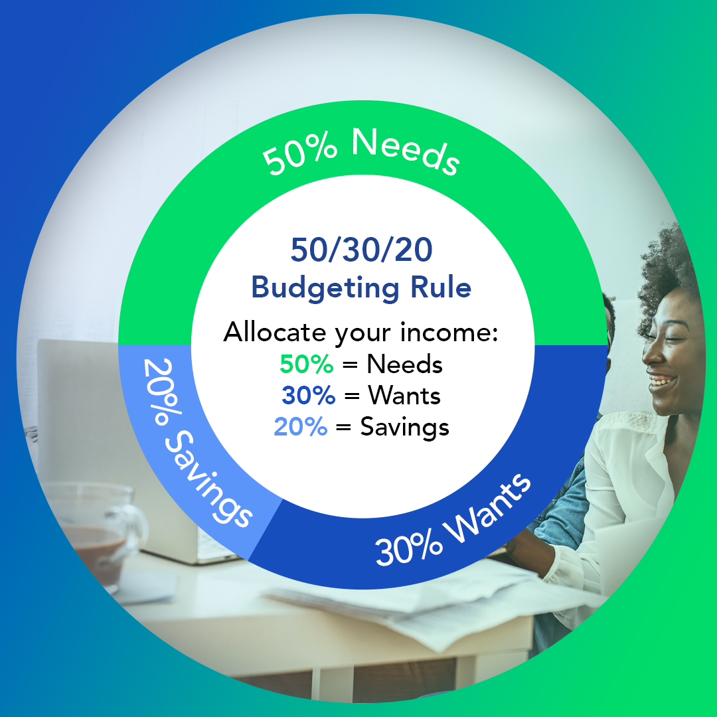
Budgeting
The 50/30/20 Budgeting Rule simplifies budgeting by dividing your after-tax income into three spending categories:
🏠 50% for Needs: Essential expenses, such as mortgage, rent, utilities, groceries, gas, etc.
🍕 30% for Wants: Nonessential expenses like clothing, restaurants, streaming services, gyms, etc.
💰 20% for Savings: Savings accounts, retirement contributions, loan and credit card payments, etc.
Achieve your financial goals in 2022 with our free [app] [invitation link and code]
#wellbeingwednesday #financialgoals #financialplanning #budget #budgeting #saving #money #finance
Successfully managing your money begins with creating and sticking to a budget. Think of budgeting as a part of your daily routine makes it less of a chore. [App] has a budget tool that makes it easy to create savings goals and trackable budgets to help you achieve your financial goals.
Achieve your budgeting goals with our free [app] [invitation link and code]
#WellbeingWednesday #FinancialLiteracyMonth
Image Link
Would you like to know where your money goes each month? Tracking your spending each month gives you better control over your finances. [App]'s provides a visual summary of all your bank account transactions to help you to identify areas where you can reduce spending and start saving.
See how you can take control of your finances with our free [app] [invitation link and code]
#FinancialLiteracyMonth #saving #budgeting #budgetfriendly #money #finance
Image Link

Slide 12



Saving
To maintain your current standard of living when you officially leave the workforce, it’s important to start saving for retirement early. Share this blog for #AmericaSavesWeek so they can learn how 401(k) and Roth IRA plans can help you to reach your savings goals.
https://finlocker.com/how-to-start-saving-for-retirement/
See how [Company] can help you stay on top of your savings goals by downloading [app] today! [invitation link and code]
#Retirement #401k #RothIRA #savingsgoals #finance #SaveToRetire #saving #money #retirement #budget #budgetgoals
If you’d like to save $10,000 this year towards your down payment, pay off debt, create an emergency fund or college savings fund, find $27 per day or $190 per week in your budget. Transfer the money to a separate savings account, paying at least 2% interest to achieve your goal within a year.
Achieve your financial goals with our free financial management tool! Download [app] today and get started: [invitation link and code]
#wellbeingwednesday #financialgoals
#financialplanning #financialfreedom #saving #money #savingmoney #finance
The best way to prepare for financial bumps in the road is with an emergency fund. Create a goal in your [app] with a target amount equal to 3 months of your current salary. This will provide a financial cushion to pay your regular expenses in case of job loss or illness. If you are the sole earner for your family or self-employed, you should aim to cover 6 - 9 months of expenses in your emergency fund.
Download [app] today to start achieving your financial goals: [invitation link and code]
#wellbeingwednesday #financialtips #financialfreedom #saving #savingmoney #finance #money

Slide 13


Saving for Children's Education
Image Link
With tuition rates increasing each year, affording higher education for your child can bring financial stress to your family. Start saving when your child is young with a 529 Savings Plan to spread the cost over more years. Check out our blog to learn more about how a 529 savings plan can benefit you and your family.
https://finlocker.com/prepare-for-education-expenses-with-a-529-savings-plan/
See how [app] can help you save for your children's future. Download today and get started! [invitation link and code]
#collegesavingsplan #highereducation #studentsuccess #saving #savings #planning #money #finance #savingsplan #education #educationsaving
College is the largest expense most families have besides the purchase of their home. Making sure you properly manage your finances while your kids are in college is crucial to staying financially stable. [Company] provides educational resources for college payments, college savings plans, financial aid, and more. Check out the education center in your [app] or the savings calculator to find all the resources that can help you stay financially fit!
https://finlocker.com/prepare-for-education-expenses-with-a-529-savings-plan/
See how the savings calculator in our [app] can help you save for your children’s education. Download today and get started! [invitation link and code]
#collegesavingsplan #highereducation #studentsuccess #saving #savings #planning #money #finance #savingsplan #education #educationsaving
Notes:
Here's what the HELOC article says about College expenses:
Despite all the discussions on how to make college more affordable, it is still the single largest expense for most families just behind the purchase of their home. The equity in their home could be used to help pay for college.
https://finlocker.com/heloc-when-to-use-home-equity-line-of-credit/

Slide 14


Home Value and Equity
Image Link
Image Link
Building equity through homeownership is the primary way most people build wealth to achieve financial stability. Here are 4 ways to increase home equity faster so you can achieve financial stability sooner:
1 – Increase your home’s property value
2 – Decrease your mortgage balance
3 – Make a larger down payment
4 – Let the market increase the value of your home
Read our blog 4 Ways to Increase Home Equity Faster for more details on each tip.
https://finlocker.com/4-ways-to-increase-home-equity-faster/
Achieve your financial goals with our free financial tool! Download [app] today and get started! [invitation link and code]
#NationalHomeownershipMonth #homeownership #homebuyer #homebuying #homeequity #homeownertips #buyingahome #homevalue #mortgage
Building home value is one of the best ways to become financially stable for the future. As a homeowner, it’s important to stay on top of any home repairs to to invest in home improvement projects. Remodels and paying off loans can work together to increase home equity.
Read our blog 4 Ways to Increase Home Equity Faster for more tips.
https://finlocker.com/4-ways-to-increase-home-equity-faster/
See how [Company] can help you plan for your future projects. Download [app] today and get started! [invitation link and code]
#NationalHomeownershipMonth #homeownership #homebuyer #homebuying #homeequity #homeownertips #buyingahome #homevalue #mortgage

Slide 15


Manage Debt
Image Link
The snowball method provides satisfaction by seeing one loan or credit card account debt paid in full. You will see a faster decrease in your total amount owed because the smaller loans are settled first. Learn more about the snowball method for paying off debt: https://finlocker.com/comparing-snowball-method-avalanche-method-to-pay-off-debt/
Manage your debt and achieve your financial goals in 2022 with our free financial fitness app! Download [app] today: [invitation link and code]
#debt #debtfree #debtfreejourney #debtfreedom #finance #credit #creditcard
Past debt can take a toll on your finances and cause financial stress as you enter life after buying a home. Learn the best practices for managing your finances to avoid past debt stopping you from pursuing your financial goals.
Achieve your financial goals in 2022 with our free financial management app! Download [app] to take control over your debt! [invitation link and code]
#FinancialReadiness #StudentSuccess #studentloans #debt #finance #debtfree #saving #money #finance #debtfreedom #debtfreejourney
Notes:
Stock Image URL:
https://www.istockphoto.com/vector/student-loan-saving-for-school-university-or-college-study-cost-concept-graduated-gm1248960190-363894241

Slide 16
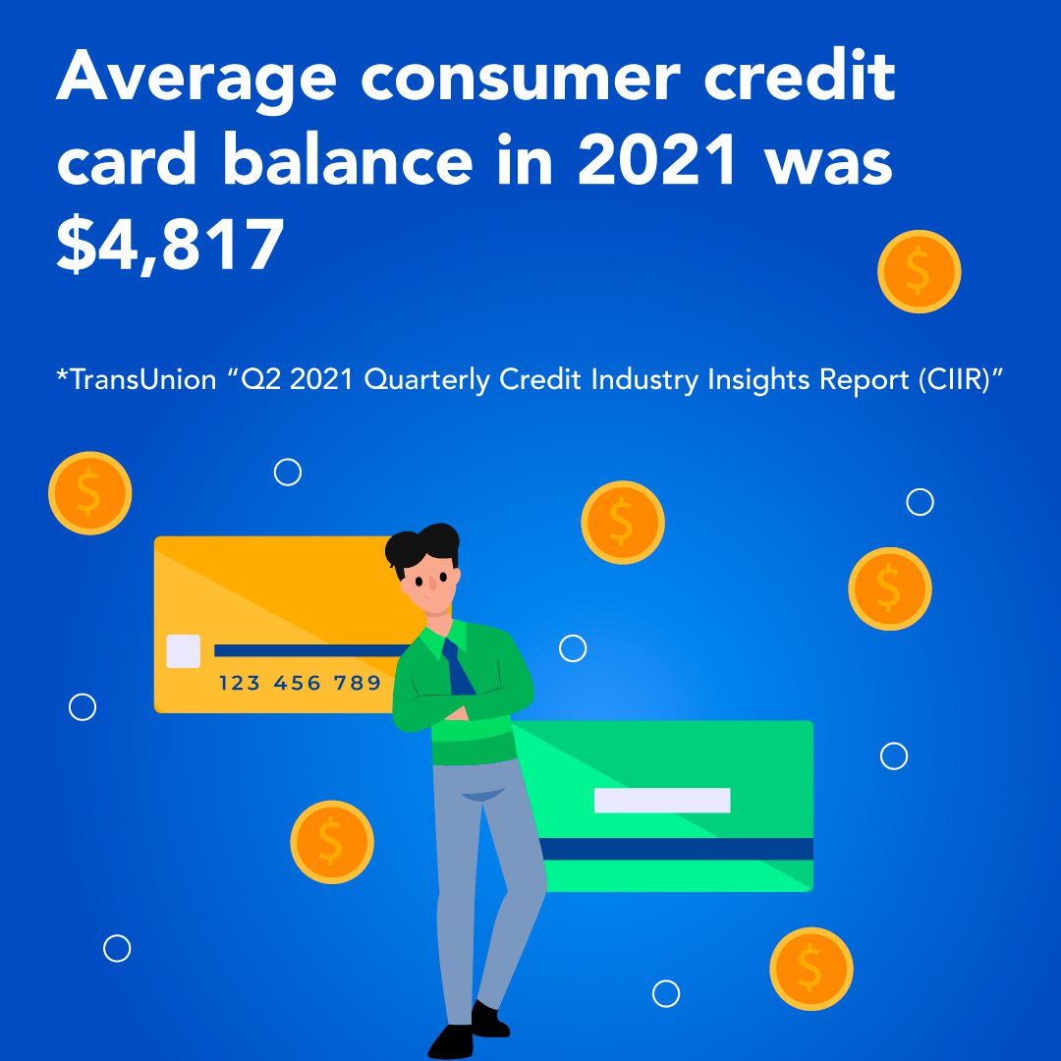

Goal: Pay Down Debt / Reduce Debt to Income ratio
Reduce your debt and reach your savings goals quicker with the avalanche method. Paying off your debt with the highest interest rate first reduces the money you pay in interest. Learn more about the avalanche method for reducing debt: https://finlocker.com/comparing-snowball-method-avalanche-method-to-pay-off-debt
Manage your debt and achieve your financial goals in 2022 with our free financial fitness app! Download [app] today: [invitation link and code]
#WellbeingWednesday #FinancialLiteracyMonth
#debt #debtfree #debtfreejourney #debtfreedom #finance #credit #creditcard
To pay down your credit card debt, pay off the credit card with the highest interest rate first. FinLocker provides a credit simulator so you can see how paying off your credit card will impact your credit score.
Manage your debt and achieve your financial goals in 2022 with our free financial fitness app! Download [app] today: [invitation link and code]
#credit #creditreport #creditbalance #creditscore #credittips #creditrepair

Slide 17


Renovate home
Image Link
Have you started to outgrow your home? Rather than move, learn how to find an architect and work towards financing a home remodel. Renovating can give greater value to your home. Read our blog to learn how to find an architect and work with them to create the plans for your home remodel:
https://finlocker.com/how-to-work-with-an-architect-on-your-home-remodel/
#WorldArchitectureDay #renovation #money #finance #remodel #remodeling #homeremodel #kitchenremodel #bathroomremodel #renovations #renovationproject #renovationlife
When searching for a new home, look for an affordable home in your preferred neighborhood that has the features you really need vs want. You can renovate a dated home with your style to make it your dream home. Buying a cheaper home with a manageable monthly payment can help you sustain homeownership to build wealth.
#WellbeingWednesday #homerenovation #homeownership #homeloans #buyinghomes #homebuyingtips #homeadvice #loanadvice #homemortgage #mortgage #credit #buyingahome #loan #homeloan #home #homebuyer #remodel #remodeling #homeremodel #renovations #renovationproject #renovationlife

Slide 18

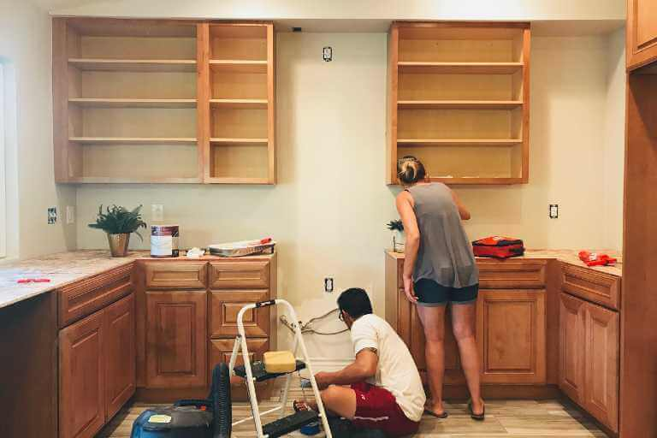
Renovate home
A cash-out refinance is a great way to use home equity to pay for expenses rather than deplete your savings. There are many reasons to refinance, but here are a couple to keep in mind:
1. Get a lower interest rate
2. Change the length of your current mortgage loan – reduce to 15 years to pay off earlier
3. Change the loan from adjustable to fixed rate or the type of loan from FHA to conventional
4. Take out some cash to finance a renovation
5. Remove someone from the title of the loan
6. Apply a lump sum and lower the loan balance
7. Consolidate your first and second mortgages together
8. Consolidate debts such as credit cards
Read more about refinancing options in our article https://finlocker.com/reasons-to-refinance-your-mortgage/
#Refinance #HomeImprovement #refinance #finance #money #loan #saving #homeequity #homeimprovement #debt #mortgage #mortgageloan
A Home Equity Line of Credit (HELOC) is a loan that establishes a line of credit based on the equity in your home. There are many reasons people apply for a HELOC, here are a few you can consider:
1. Home improvements – the money could be used to finance repairs or renovations
2. Debt consolidation – pay off high interest credit cards by taking advantage of the lower rates offered by a HELOC
3. College expenses – help pay for college using your home equity
4. Emergency funds – As a line of credit, HELOC can be useful in emergencies
https://finlocker.com/heloc-when-to-use-home-equity-line-of-credit/
#HomeImprovement #HELOC #loan #renovation #homeimprovement #home #money #finance #saving #renovationlife #college #debt #moneymanagement
Notes:
8 Reasons to Refinance Your Mortgage
https://finlocker.com/reasons-to-refinance-your-mortgage/
HELOC: When to Use a Home Equity Line of Credit
https://finlocker.com/heloc-when-to-use-home-equity-line-of-credit/
Refer to the app providing educational resources on home equity and an interactive home equity line of credit (HELOC) calculator to help oyu determine if a HELOC will help you to finance a home renovation

Slide 19


Digital Preparedness
Homebuyers are required to disclosure of a lot of personal information during the mortgage process. Transferring personal and financial documents from your [app] account to your lender helps to minimize your financial risk. Learn more about how [app] keeps your financial accounts and documents safe.
#NationalCyberSecurityMonth #TerminologyTuesday #HomebuyingTips #security #finance #money #protected #secure #cybersecurity #cybersecurityawareness
Whether you’re shopping, paying bills or managing your money, we all enjoy the convenience of conducting financial transactions online. Learn the common types of cybercrime and how to avoid becoming a victim.
https://finlocker.com/keeping-your-personal-information-secure-during-financial-transactions/
#NationalCyberSecurityAwarenessMonth #cybersecurity #security #securitysystem #cybersecurity #cybersecurityawareness

